Slide 1
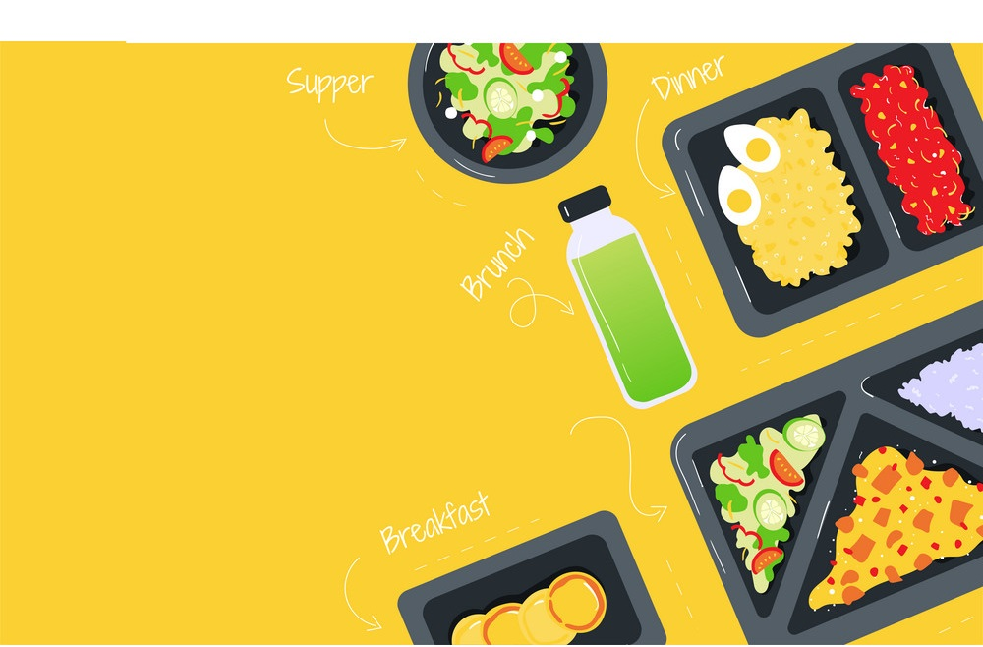
So-Yummy-Desserts

Slide 2
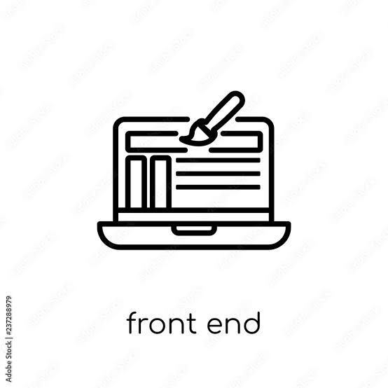
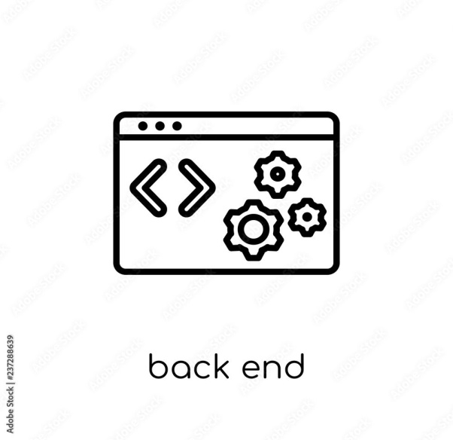
PROJECT MEMBERS
Mekala Sai Sunanth - 2489028
Maram Sandhya -2487553
Mashti Nagaraju -2486865
Nagaveni H K -2489426
Mohammed Owais -2489160
Neha Narayan Desai - 2487271
Pallavi Sunil Pawar - 2487696
Namrata Shrishail Tarade - 2488363
Namratha U - 2487000
Md Iqbal Quraishi - 2488957

Slide 3
ABSTRACTION
An Online Food Ordering System is proposed here which simplifies the food ordering process. The proposed system shows an user interface and update the menu with all available options so that it eases the customer work.
Customer can choose more than one item to make an order and can view order details before logging off. The order confirmation is sent to the customer.
The order is placed in the queue and updated in the database and returned in real time. This system assists the staff to o through the orders in real time and process it efficiently with minimal errors.

Slide 4
INTRODUCTION
The labour rates are increasing steadily year on year thus making it difficult to find employees. The food industry is highly labour intensive and the biggest expense in the food industry is the cost of employing the right kind of people to do the work.
One of the ways to reduce this expense is to use modern technology to replace some of the jobs done by human beings and make machines do the work.
Here we propose an “Online Food Ordering System” that has been designed for Fast Food restaurant, Take-Out or College Cafeterias.
The system can also be used in any food delivery industry. This simplifies the process of food ordering for
both the customer and the restaurant, as the entire process of taking orders is automated.

Slide 5
TECHNOLOGY USED
HTML : Page layout has been designed in HTML
CSS : CSS has been used for all the designing part
JavaScript : All the validation task and animations has been developed by JavaScript
JSP : All the front end logic has been written in JSP
Java : All the business logic has been written in Java
MySQL : MySQL database has been used as database for the project
Angular CLI : Command-line interface tool that we use to initialize.

Slide 6
ENVIRONMENTS
The system will be developed on any Windows OS machine using J2EE, Hibernate and Spring.
Intel hardware machine (PC P4-2.26 GHz, 512 MB RAM, 40 GB HDD)
Server – Apache Tomcat 8
Database – My SQL
My SQL J Connector
Node Version 10
Angular CLI
JDK 1.8
Eclipse IDE or Spring Tool Suite

Slide 7
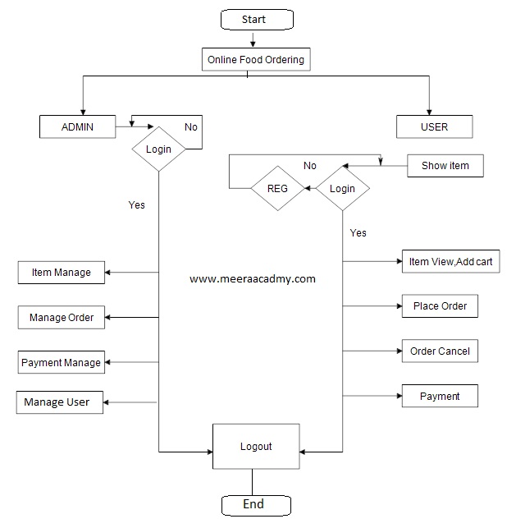
ER-DAIGRAM

Slide 8
MODULES OF ONLINE FOOD DELIVERY SYSTEM
Registration Page.
Login Page.
User Login/Logout
Admin Login.
Dashboard.
Search Products.
Add Cart/View Cart.
View Previous Active Orders.
Payment Gateway Page.
Order Summary Confirmation Page.

Slide 9
ADVANTAGES
1.Urban Restaurants, Reach Out to Remote Foodies
You captured the foodies of the complete city! Are you sure? Why not extend out the reach to the remote foodies.
2. Pinchpenny? Get Cashback
You love the restaurant food but you want to save money as well, don’t worry. We have got discounts for you.
3. Reserve that Quiet Side Table for Your Next Gathering
Tired of facing the problem of last-minute bookings and cancellations of the tables at the time of your gatherings.
4. Save Your Hard-earned Money, Order food with Discounted Deals
Without having a unique idea, it becomes challenging succeed in this competitive market. Especially in the food delivery industry, it comes difficult to earn people’s trust.

Slide 10
DISADVANTAGES
1.Deliverymen Put Themselves in Danger
Whether it is a heatwave boiling down the city or it is snowing or raining heavily, a Delivery Boy is waiting outside the restaurant to pick and deliver your order. This is one of the disadvantages of ordering food online.
2. Disguised Increased Expense
We surely get attracted by yummy-looking food pictures on the app and a small but highlighting banner of cashback offer.
3. Revenue Conflicts Between The Restaurants and Delivery Providers
Not every restaurant owner can afford to employ ten delivery boys and bear all the transport and remuneration expenditure; so, they choose to contract with the delivery service providers through these apps. This brings the disadvantages of food delivery service

Slide 11
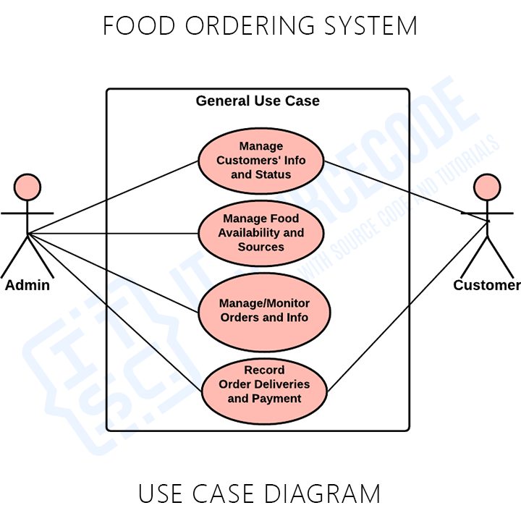
PROJECT FLOW

Slide 12
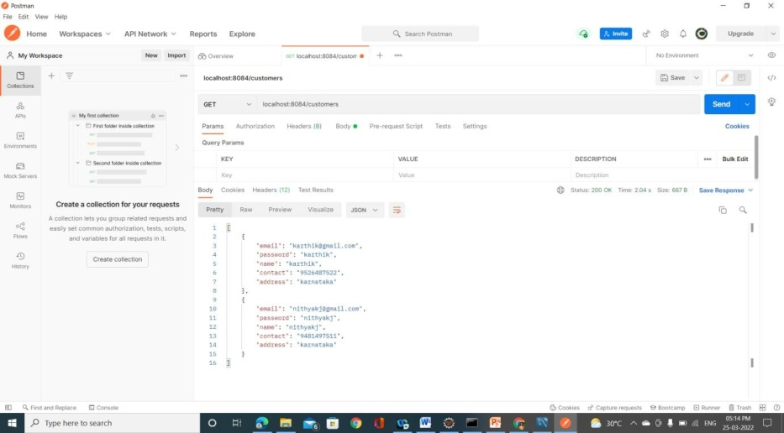
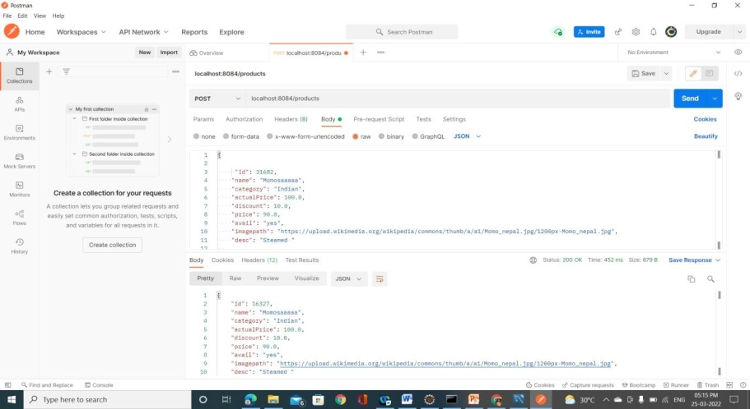
Postman Screenshots

Slide 13
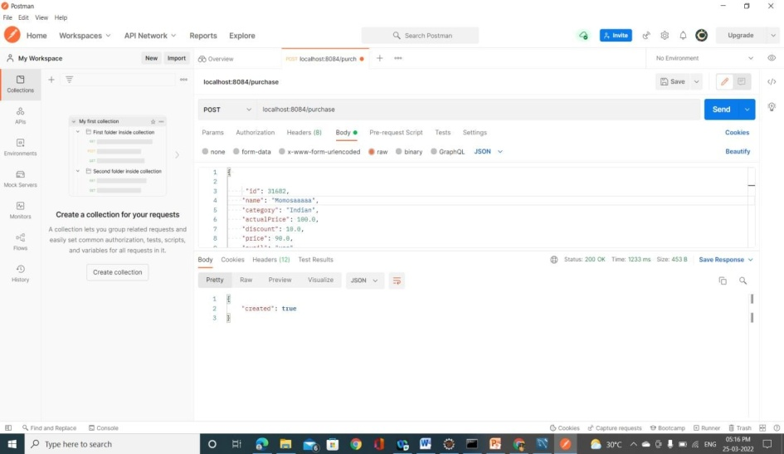
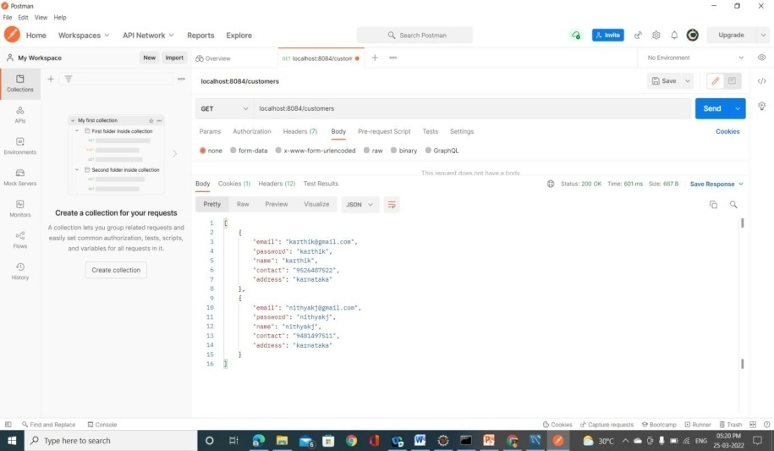

Slide 14
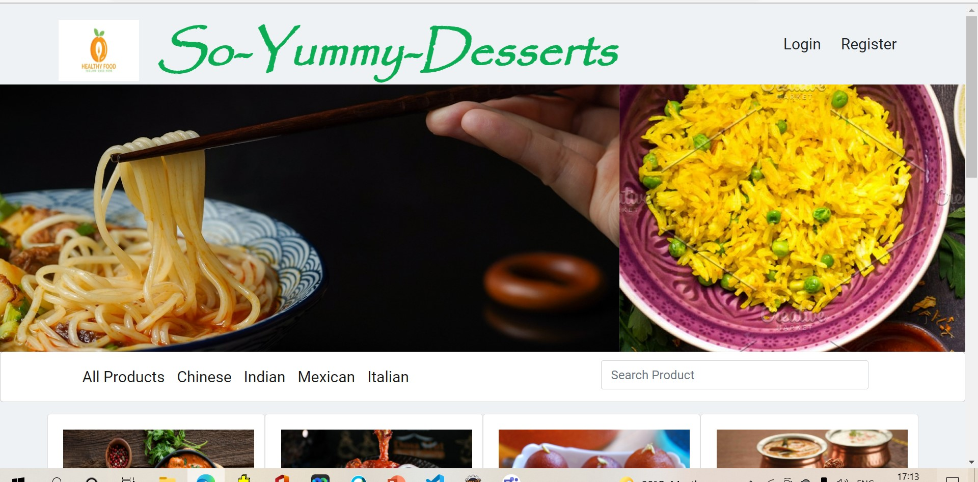
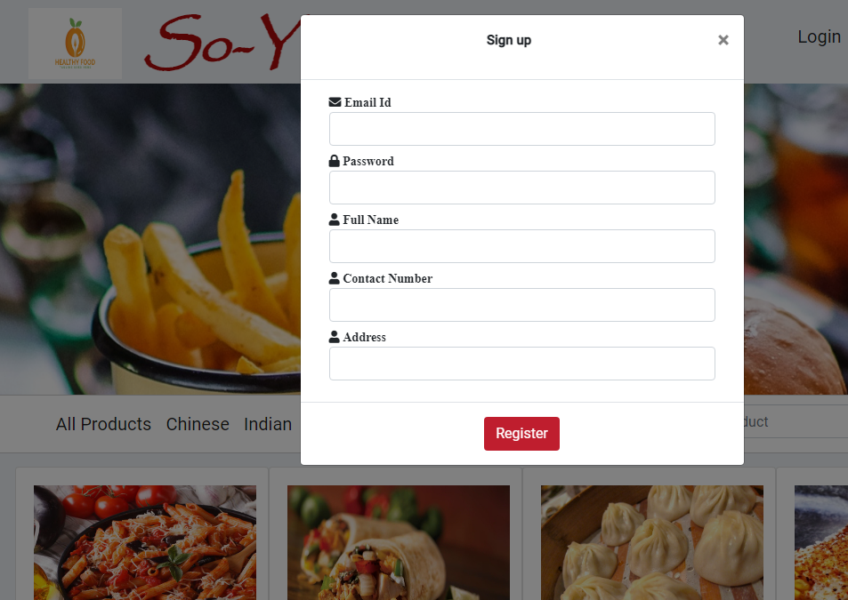
OUTPUT SCREENSHOTS
Restaurant Page
Register Page

Slide 15
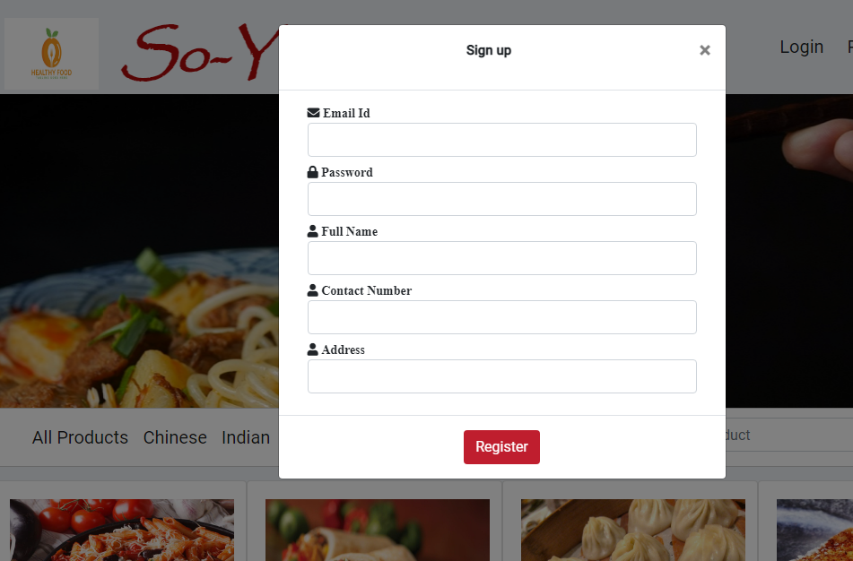
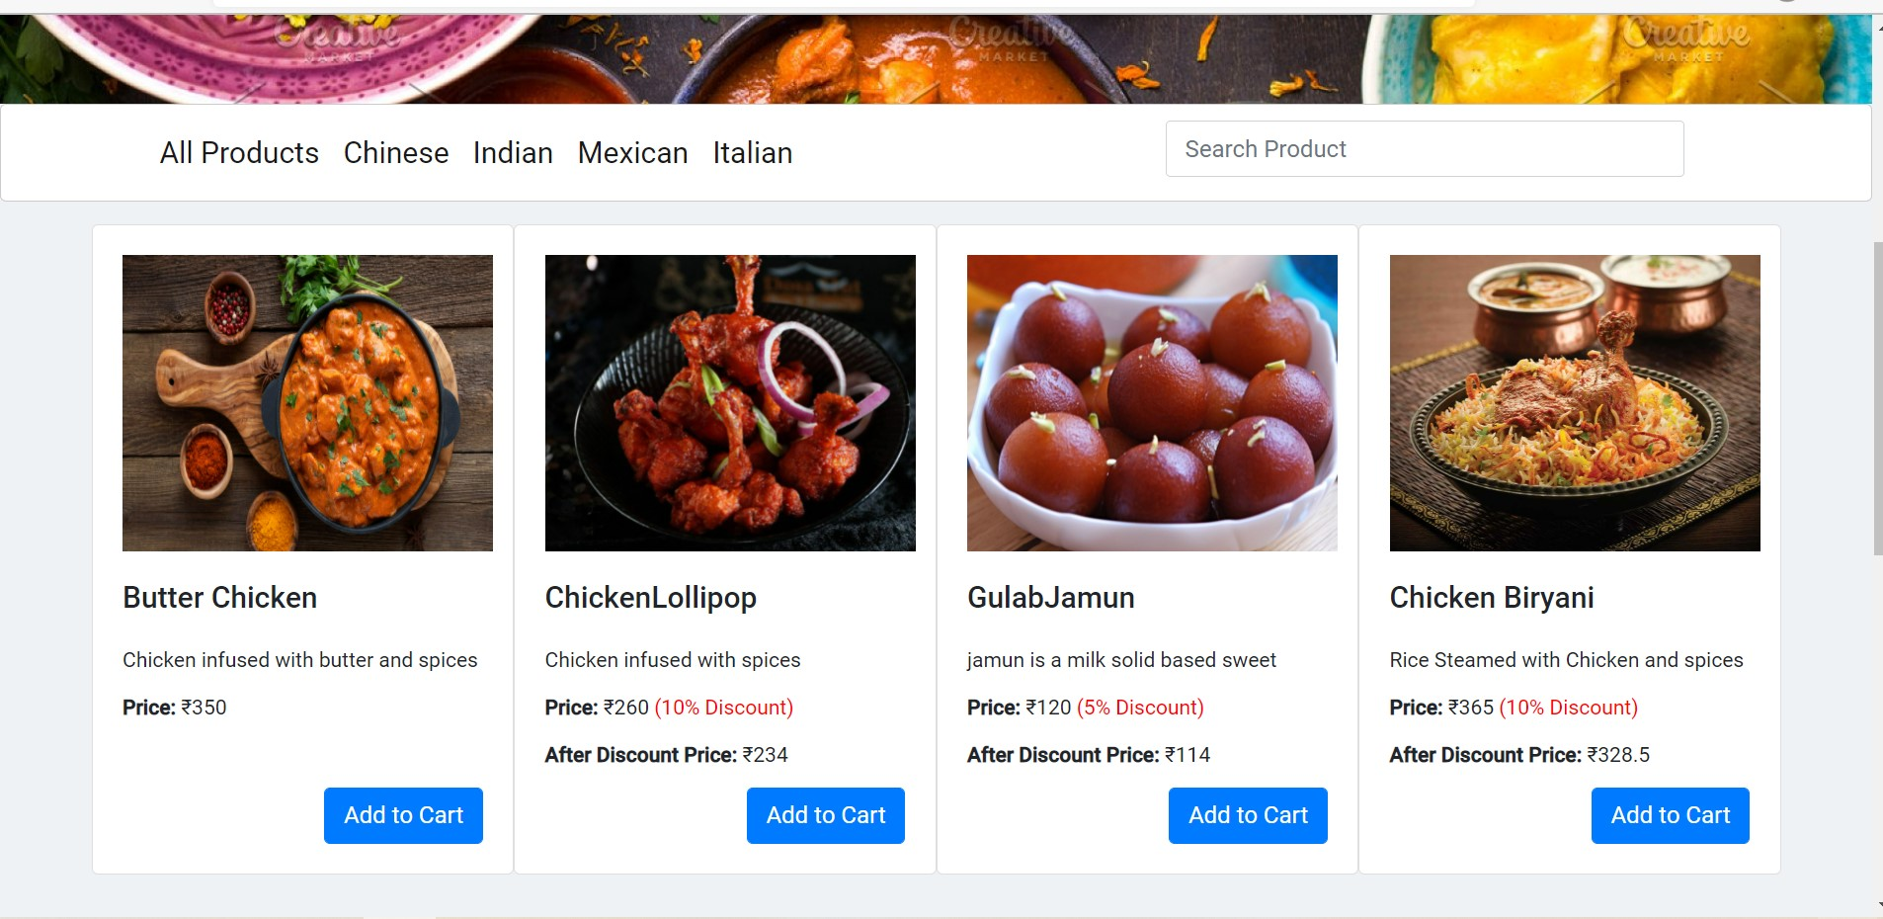
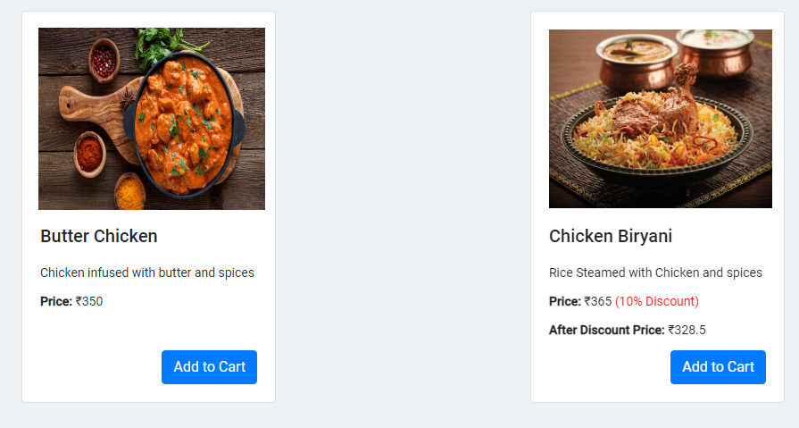
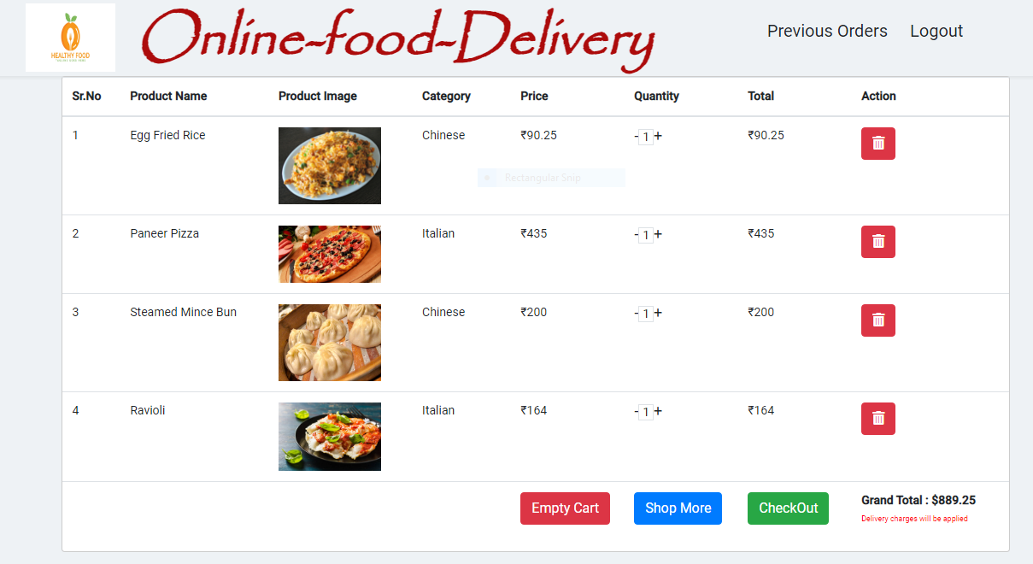
User Page
All Products
Indian Product
After adding products to cart

Slide 16
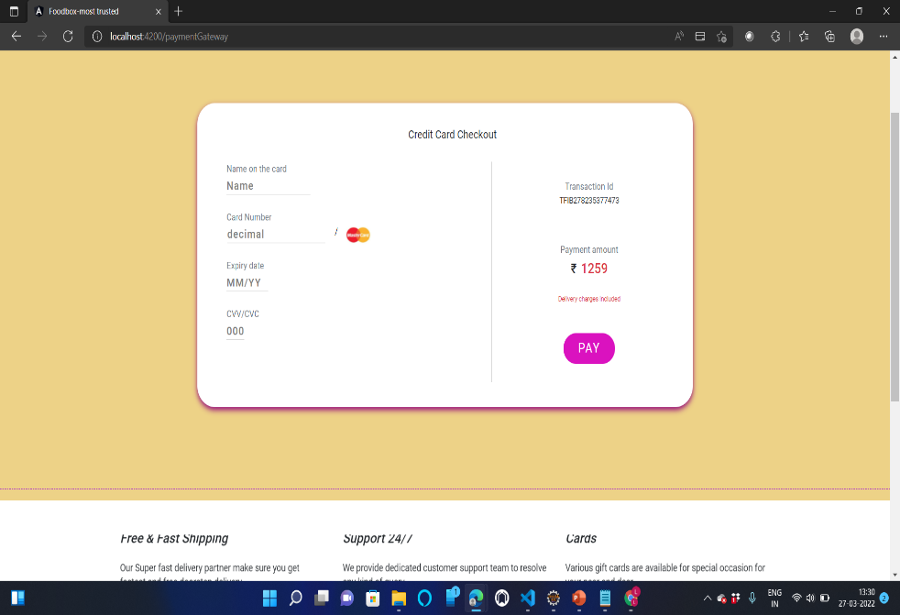
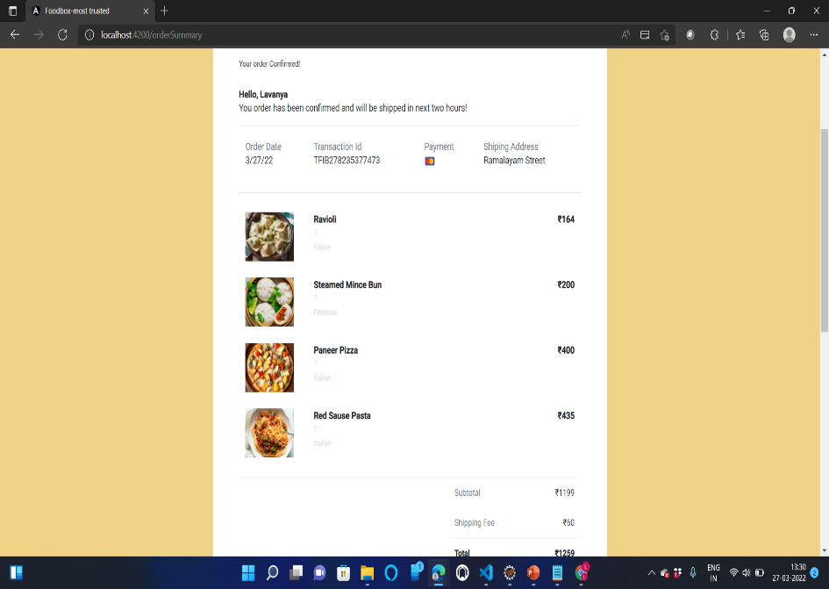
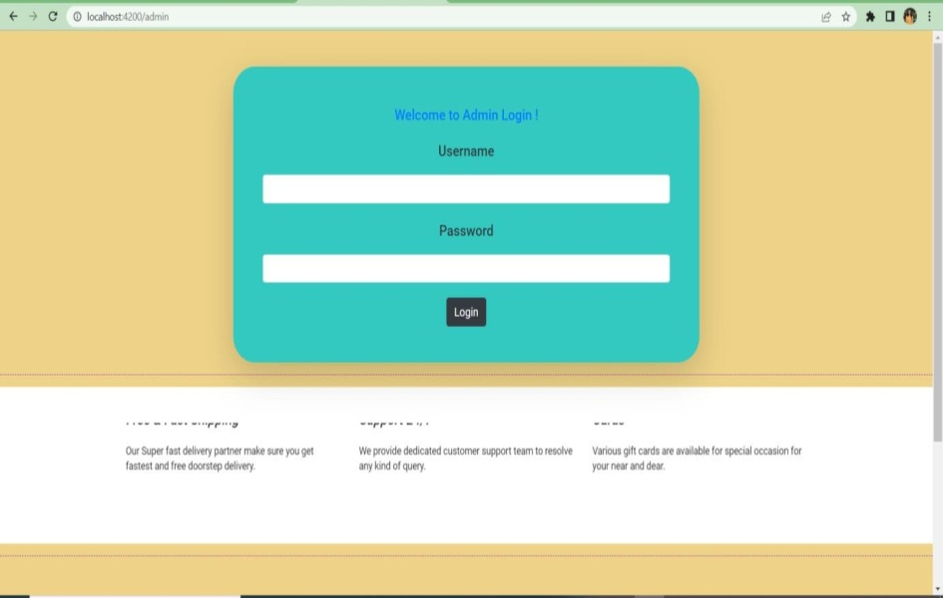
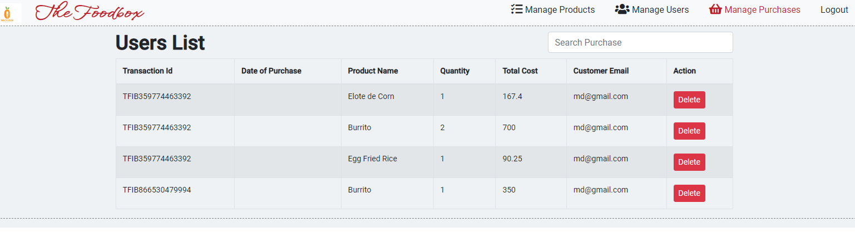

Card details
After payment order cofirmed
Admin Managing the customers

Slide 17
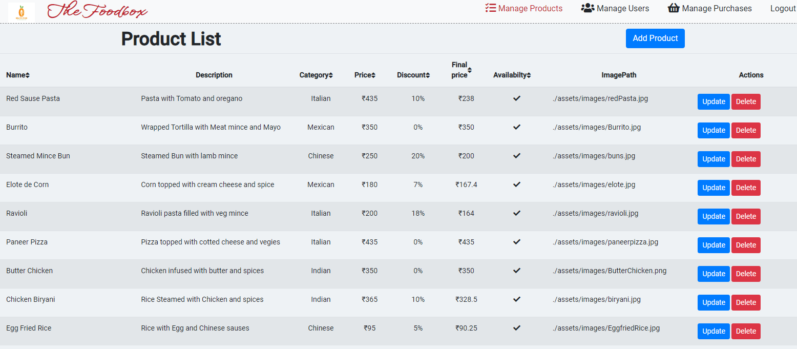
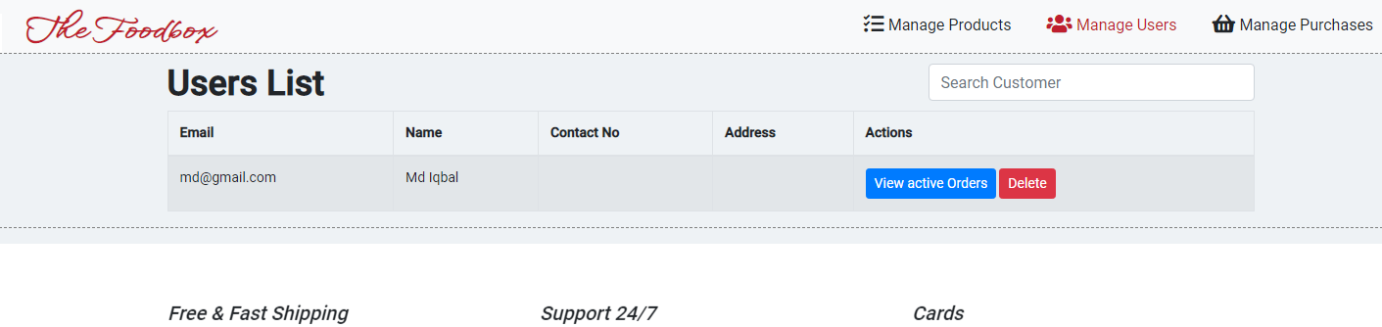
Admin can add a product
Admin managing the users

Slide 18
CONCLUSION
An online food ordering system is developed where the customers can make an order for the food and avoid the hassles of waiting for the order to be taken by the waiter.
Using the application, the end users register online, read the E-menu card and select the food from the e-menu card to order food online. Once the customer selects the required food item the chef will be able to see the results on the screen and start processing the food.
To provide a bug-free Online Food Delivery system to Users as well as Admin.The main objective is here to provide a nice and secure platform for Ordering Food.To maintain the records of Product, Category available into the system.

Slide 19
THANK YOU

